Slide 1

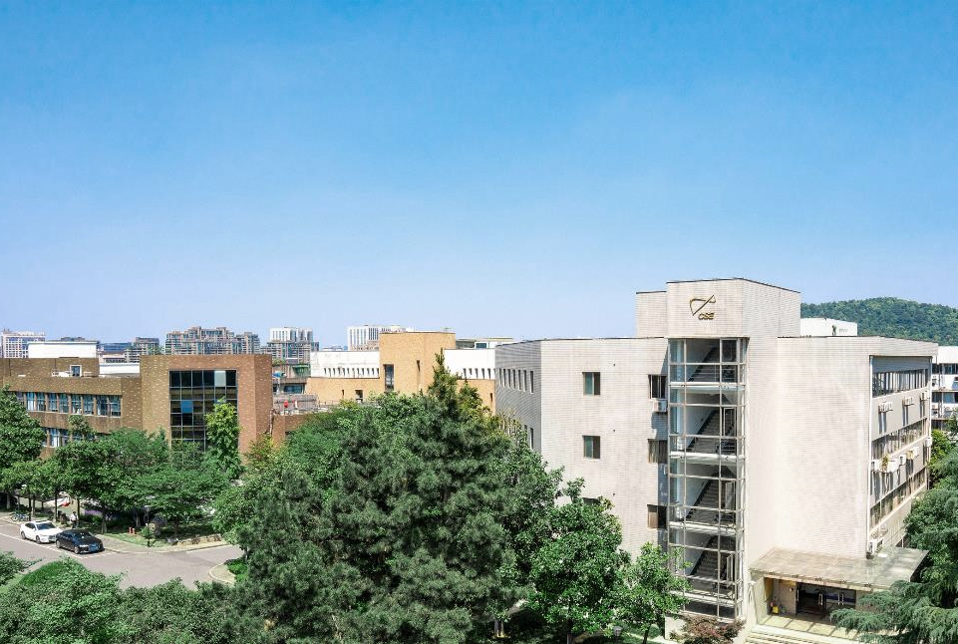
Physics based
modeling
presenter：Zhang Shuai
2025年11月27日
Notes:
Hello professor,welcome to Zhejiang university ,I am a master student of professor anjan.I will report my research direction to you. Trend- and reference-Guided Hybrid Modeling of Temperature-Dependent Thermophysical Properties.

Slide 2
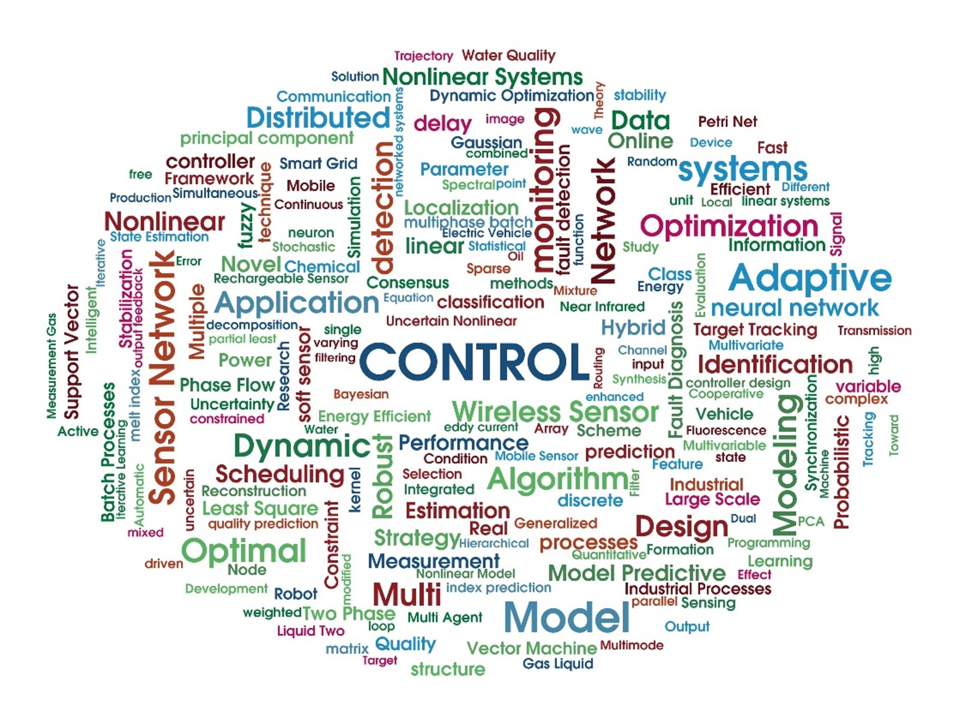
01/Background
02/Problems
Catalog
03/Methods
04/Results
Notes:
I will introduce my work through 4 parts.

Slide 3

01
Background

Slide 4
Why Property Prediction Matters
Product design
2
Materials Science
1
3
Food Science
Properties
pharmaceutical industry
6
4
Environmental Science
5
energy sector
Notes:
We face an extreme label imbalance: most chemicals lack measured attributes, so prediction is essential to fill the gaps.
Without reliable property data/models, digital design (process modeling, scale-up, optimization) simply doesn’t converge or generalize.
Predictive models prioritize what to test, reducing cycles, time-to-decision, and material waste.

Slide 5
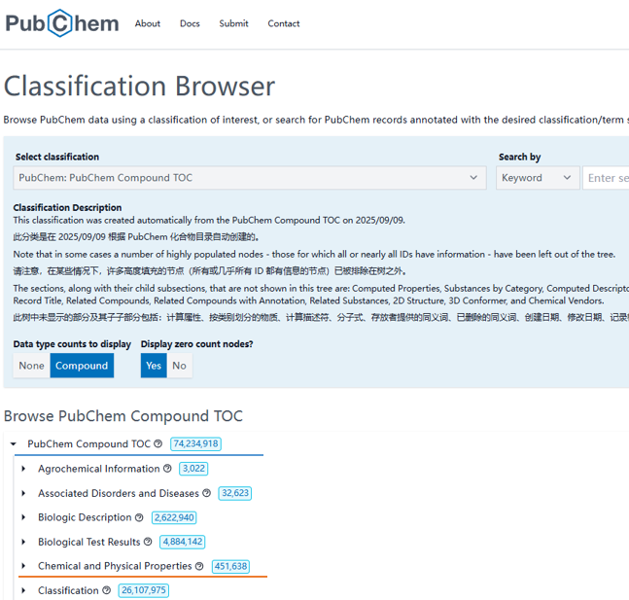
Why Property Prediction Matters
Vast chemical space, scarce labels.
PubChem lists ~74 million compounds, but fewer than ~450000 have experimentally measured properties.
Notes:
We face an extreme label imbalance: most chemicals lack measured attributes, so prediction is essential to fill the gaps.
Without reliable property data/models, digital design (process modeling, scale-up, optimization) simply doesn’t converge or generalize.
Predictive models prioritize what to test, reducing cycles, time-to-decision, and material waste.

Slide 6
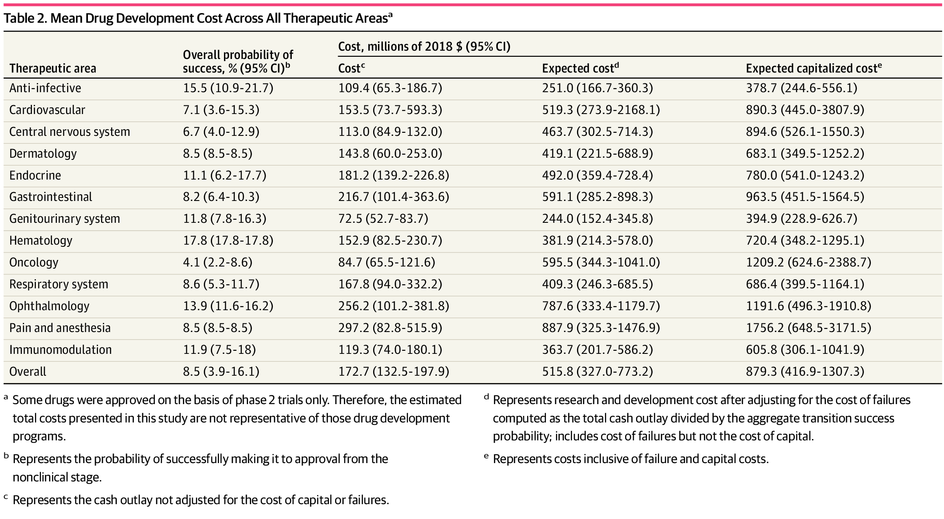
Why Property Prediction Matters
Resource limits drive trial-and-error
Under resource constraints, traditional empirical, trial-and-error approaches are ill-suited, leading to extended timelines and material waste.
From: Costs of Drug Development and Research and Development Intensity in the US, 2000-2018
Notes:
We face an extreme label imbalance: most chemicals lack measured attributes, so prediction is essential to fill the gaps.
Without reliable property data/models, digital design (process modeling, scale-up, optimization) simply doesn’t converge or generalize.
Predictive models prioritize what to test, reducing cycles, time-to-decision, and material waste.

Slide 7
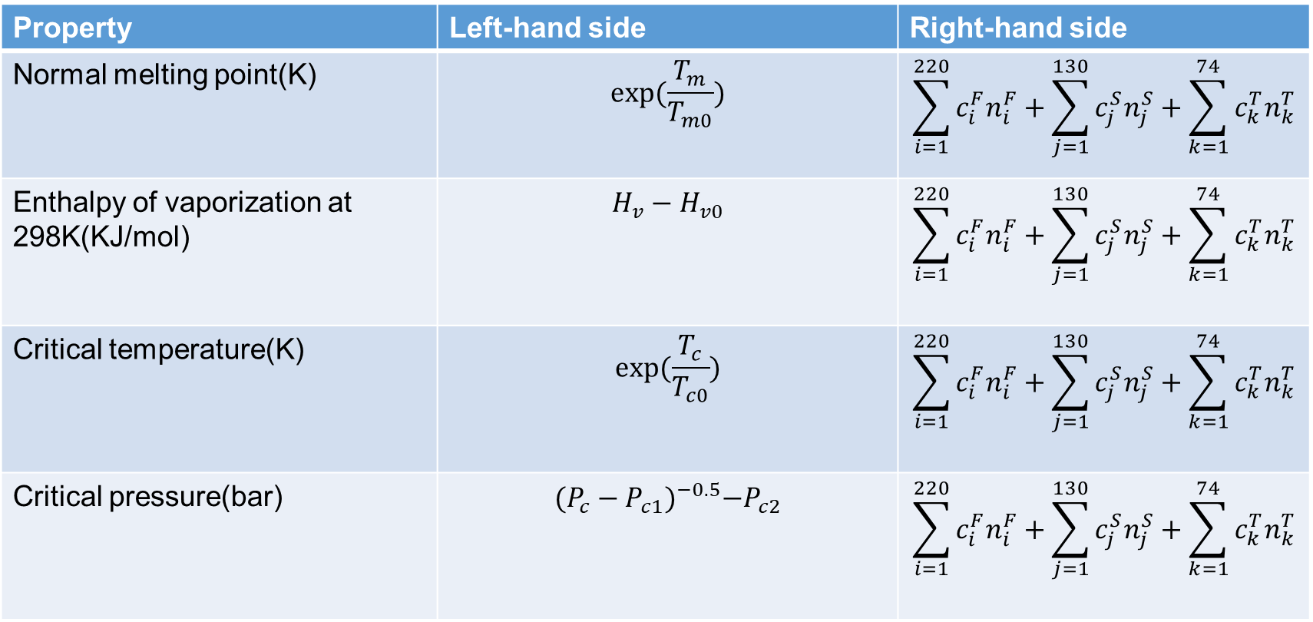
Two Types of Property Prediction
Single point model
Property | Left-hand side | Right-hand side
Normal melting point(K) | $$exp⁡(\frac{T_{m}}{T_{m0}})$$ | $$\sum_{i=1}^{220}{c_{i}^{F}n_{i}^{F}}+\sum_{j=1}^{130}{c_{j}^{S}n_{j}^{S}}+\sum_{k=1}^{74}{c_{k}^{T}n_{k}^{T}}$$
Enthalpy of vaporization at 298K(KJ/mol) | $$H_{v}−H_{v0}$$ | $$\sum_{i=1}^{220}{c_{i}^{F}n_{i}^{F}}+\sum_{j=1}^{130}{c_{j}^{S}n_{j}^{S}}+\sum_{k=1}^{74}{c_{k}^{T}n_{k}^{T}}$$
Critical temperature(K) | $$exp⁡(\frac{T_{c}}{T_{c0}})$$ | $$\sum_{i=1}^{220}{c_{i}^{F}n_{i}^{F}}+\sum_{j=1}^{130}{c_{j}^{S}n_{j}^{S}}+\sum_{k=1}^{74}{c_{k}^{T}n_{k}^{T}}$$
Critical pressure(bar) | $${(P_{c}−P_{c1})}^{−0.5}−P_{c2}$$ | $$\sum_{i=1}^{220}{c_{i}^{F}n_{i}^{F}}+\sum_{j=1}^{130}{c_{j}^{S}n_{j}^{S}}+\sum_{k=1}^{74}{c_{k}^{T}n_{k}^{T}}$$
Notes:
Currently, property prediction is generally divided into two types: temperature-dependent and single-temperature.We use the molecular structures of organic compounds, along with temperature and molecular descriptors, to train models and obtain predictive results for target properties.

Slide 8
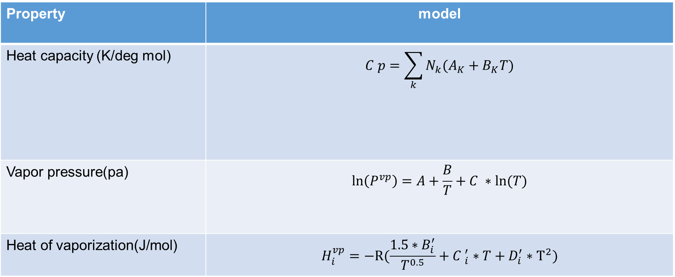
Two Types of Property Prediction
Temperature dependent model
Property | model
Heat capacity (K/deg mol) | $$C p=\sum_{k}{N_{k}(A_{K}+B_{K}T)}$$
Vapor pressure(pa) | $$\ln\left(P^{vp}\right)=A+\frac{B}{T}+C ∗ln⁡(T)$$
Heat of vaporization(J/mol) | $$H_{i}^{vp}=−R⁡(\frac{1.5∗B_{i}^{′}}{T^{0.5}}+{C }_{i}^{′}∗T+D_{i}^{′}∗T^{2})$$
Notes:
Currently, property prediction is generally divided into two types: temperature-dependent and single-temperature.We use the molecular structures of organic compounds, along with temperature and molecular descriptors, to train models and obtain predictive results for target properties.

Slide 9
Two Types of Property Prediction & Study Counts (2020–2024)
Notes:
Temperature dependent topic:("organic compound*" OR "organic chemical*") AND (QSPR OR "quantitative structure-property relationship" OR "model" OR "estimation") AND ("temperature dependen*" OR "thermal propert*" OR "vapor pressure" OR "heat capacity") single point topic:("at 298 K" OR "at 300 K" OR "at 25 C" OR "room temperature" OR "ambient temperature" OR isothermal OR STP OR "standard conditions") AND ("vapor pressure" OR viscosity OR "heat capacity" OR density OR "thermal conductivity" OR "surface tension" OR propert*) AND (predict* OR model* OR correlation* OR "group contribution" OR QSPR OR QSAR OR "machine learning" OR "parameter estimation" OR regression)

Slide 10

02
Problems

Slide 11
Main problems
Notes:
the GC model's inherent difficulty in closely tracking the true variation trend,

Slide 12
Main problems
Notes:
and QSPR/ML models producing sudden, unphysical jumps at certain points due to their lack of physical consistency.

Slide 13

03
Methods

Slide 14
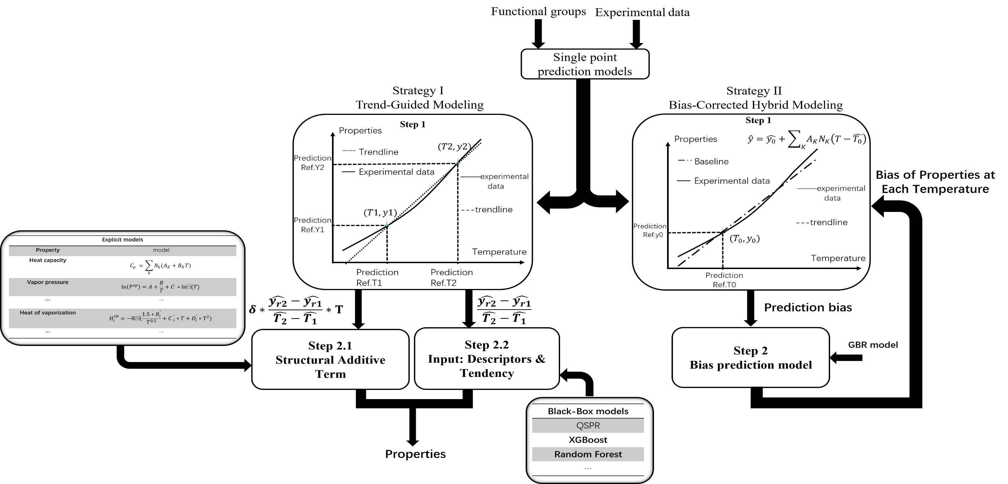
Flowchart of the hybrid modeling framework

Slide 15
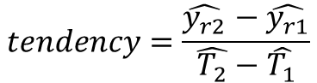

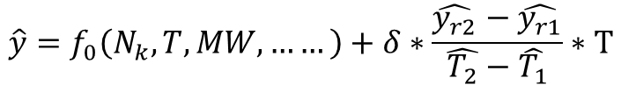
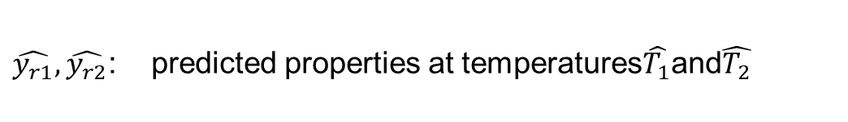
Two strategies
Tendency as a new feature
Use two high-accuracy single-temperature predictors (e.g., at $T_{a}$and）to estimate the temperature tendency of the property, then feed this tendency as a new input feature to the model.
(A) Explicit / Mechanistic Models
$$\hat{y}=f_{0}\left(N_{k},T,MW,……\right)$$
$$\hat{y}=f_{0}\left(N_{k},T,MW,……\right)+δ∗\frac{\hat{y_{r2}}−\hat{y_{r1}}}{\hat{T_{2}}−\hat{T_{1}}}∗T$$
(B) Black-Box / Data-Driven Models
$$\hat{y}=f_{0}\left(N_{k},T,MW,……,\frac{\hat{y_{r2}}−\hat{y_{r1}}}{\hat{T_{2}}−\hat{T_{1}}}\right)$$
$$\hat{y}=f_{0}\left(N_{k},T,MW,……\right)$$
$$tendency=\frac{\hat{y_{r2}}−\hat{y_{r1}}}{\hat{T_{2}}−\hat{T_{1}}}$$
$\hat{T_{1}},\hat{T_{2}}$: Two reference temperature points
$\hat{y_{r1}},\hat{y_{r2}}$: predicted properties at temperatures$\hat{T_{1}}$and$\hat{T_{2}}$

Slide 16
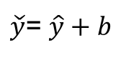

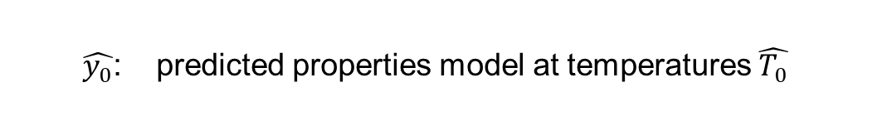
Two strategies
Reducing bias through physical anchors
Use one high-accuracy single-temperature predictor as a reference point (anchor), fit a baseline function to experimental data, then learn the residual (bias) with ML and add it back.
Baseline
$$\hat{y}=\hat{y_{0}}+\sum_{K}{A_{K}N_{K}(T−\hat{T_{0}})}$$
$\hat{T_{0}}$: reference temperature point model
$\hat{y_{0}}$: predicted properties model at temperatures $\hat{T_{0}}$
Bias prediction model
$b=y−$ $\hat{y}$
$$\hat{b}=f_{0}\left(N_{k},T,MW…… \right)$$
Compensation formula
$\check{y}$= $\hat{y}+b$

Slide 17

04
Results

Slide 18
Overall Model Performance
Properties |  | GC | GC+ | ML | ML+ | ML++ | QSPR | QSPR+
Heat capacity | R2 | 0.9918 | 0.9924 | 0.9986 | 0.9988 | 0.998120 | 0.9994 | 0.9994
 | MSE | 16.08 | 14.89 | 2.78 | 2.43 | 3.66 | 1.19 | 1.14
Vapor pressure | R2 | 0.9033 | 0.9194 | 0.9647 | 0.9715 | 0.9914 | 0.9886 | 0.9901
 | MSE | 63.04 | 52.58 | 23.04 | 18.55 | 5.59 | 7.41 | 6.43
Heat Of vaporization | R2 | 0.9260 | 0.9534 | 0.9893 | 0.9950 | 0.9941 | 0.9929 | 0.9961
 | MSE | 64.55 | 40.66 | 9.37 | 4.34 | 5.14 | 6.15 | 3.40

Slide 19
Overall Model Performance
Properties |  | ML | ML+ | ML++ | QSPR | QSPR+
Volume | R2 | 0.9981 | 0.9988 | 0.998468 | 0.9991 | 0.9992
 | MSE | 89.56 | 57.64 | 73.67 | 41.83 | 37.78
Internal Energy | R2 | 0.9987 | 0.9989 | 0.999556 | 0.9991 | 0.9992
 | MSE | 18.54 | 15.68 | 6.36 | 12.59 | 11.51
Pure component enthalpy | R2 | 0.9991 | 0.9991 | 0.999569 | 0.9991 | 0.9992
 | MSE | 13.62 | 13.08 | 6.18 | 13.17 | 11.00

Slide 20
Overall Model Performance
Properties |  | ML | ML+ | ML++ | QSPR | QSPR+
pure component exergy | R2 | 0.9962 | 0.9991 | 0.998660 | 0.9992 | 0.9992
 | MSE | 16.76 | 3.99 | 5.90 | 3.59 | 3.53
pure component isentropic exponent | R2 | 0.9894 | 0.9955 | 0.995552 | 0.9931 | 0.9955
 | MSE | 93.74 | 39.74 | 39.37 | 61.24 | 40.08
Liquid density | R2 | 0.9902 | 0.9948 | 0.99569857 | 0.9932 | 0.9950
 | MSE | 18.23 | 9.61 | 8.00 | 12.53 | 9.23
Pure component Gibbs free energy | R2 | 0.9933 | 0.9958 | 0.997480 | 0.9957 | 0.9971
 | MSE | 21.32 | 13.40 | 8.05 | 13.80 | 9.27

Slide 21
Overall Model Performance
Properties |  | GC | GC+ | ML | ML+ | ML++ | QSPR | QSPR+
Heat capacity | <=1% | 380 | 406 | 987 | 993 | 778 | 1244 | 1256
 | <=5% | 1519 | 1494 | 2004 | 2006 | 1858 | 2032 | 2034
 | <=10% | 1884 | 1909 | 2060 | 2056 | 2017 | 2066 | 2067
Vapor pressure | <=1% | 198 | 219 | 249 | 253 | 335 | 308 | 311
 | <=5% | 865 | 930 | 960 | 1030 | 1377 | 1235 | 1252
 | <=10% | 1332 | 1389 | 1571 | 1557 | 1810 | 1736 | 1756
Heat Of vaporization | <=1% | 224 | 223 | 600 | 727 | 647 | 823 | 939
 | <=5% | 935 | 984 | 1670 | 1819 | 1806 | 1795 | 1919
 | <=10% | 1493 | 1572 | 1969 | 2010 | 1992 | 1990 | 2019

Slide 22
Overall Model Performance
Properties |  | ML | ML+ | ML++ | QSPR | QSPR+
Volume | <=1% | 1148 | 1192 | 1080 | 1410 | 1629
 | <=5% | 2036 | 2048 | 2025 | 2064 | 2072
 | <=10% | 2067 | 2075 | 2066 | 2078 | 2079
Internal Energy | <=1% | 1240 | 1276 | 1312 | 1381 | 1409
 | <=5% | 1914 | 1922 | 1941 | 1944 | 1959
 | <=10% | 1982 | 2001 | 1997 | 2008 | 2008
Pure component enthalpy | <=1% | 1321 | 1333 | 1401 | 1431 | 1452
 | <=5% | 1959 | 1956 | 1959 | 1984 | 1981
 | <=10% | 2006 | 2004 | 1996 | 2025 | 2021

Slide 23
Overall Model Performance
Properties |  | ML | ML+ | ML++ | QSPR | QSPR+
Pure component Gibbs free energy | <=1% | 420 | 492 | 367 | 524 | 553
 | <=5% | 1233 | 1397 | 1229 | 1343 | 1474
 | <=10% | 1516 | 1685 | 1548 | 1619 | 1718
Liquid density | <=1% | 1326 | 1417 | 1436 | 1380 | 1456
 | <=5% | 2023 | 2060 | 2062 | 2048 | 2054
 | <=10% | 2070 | 2070 | 2070 | 2070 | 2070
pure component isentropic exponent | <=1% | 1348 | 1537 | 1515 | 1434 | 1518
 | <=5% | 2022 | 2068 | 2062 | 2053 | 2064
 | <=10% | 2070 | 2070 | 2070 | 2070 | 2070
pure component exergy | <=1% | 810 | 843 | 468 | 1001 | 1021
 | <=5% | 1454 | 1506 | 1264 | 1623 | 1645
 | <=10% | 1663 | 1744 | 1529 | 1802 | 1811

Slide 24
Overall Model Performance

Slide 25
Overall Model Performance

Slide 26
Overall Model Performance

Slide 27
Overall Model Performance

Slide 28
Overall Model Performance

Slide 29
Overall Model Performance

Slide 31
Overall Model Performance

Slide 32
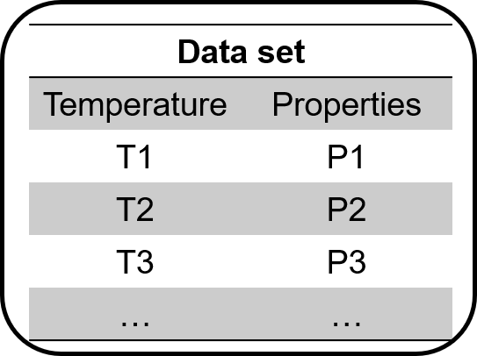
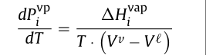
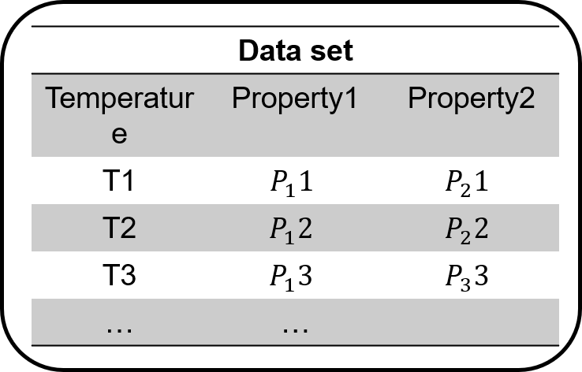



Next step
Experimental data 1
Property 1
$$f_{1}\left(N_{k},T,MW,……\right)$$
$$∝$$
$$∝$$
$$f_{1 2}\left(N_{k},T,MW,……\right)$$
Property 2
$$f_{2}\left(N_{k},T,MW,……\right)$$
Experimental data 2

Slide 33
Thank you
presenter：Shuai Zhang
2025年11月27日

